Slide 1
PROJECT CHARTER

Slide 2

WHAT IS PROJECT CHARTER??

Slide 3
is a statement of the scope, objectives and participants in a project
preliminary delineation of roles and responsibilities
outlines the project objectives
identifies the main stakeholders
and defines the authority of the project manager

Slide 4
STEPS TO MAKE PROJECT CHARTER
General Information:
Date
Project Title
Project Sponsor: person who champions your project. Typically, they also control the money and resources and is the senior end customer
Start/Finish Date

Slide 5
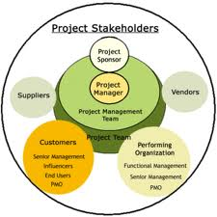
2. Stake Holders
(A Stakeholder can be a person, a group, or an organization that may be affected, or have any kind interest in the project or in project’s outcome either directly or indirectly)

Slide 6
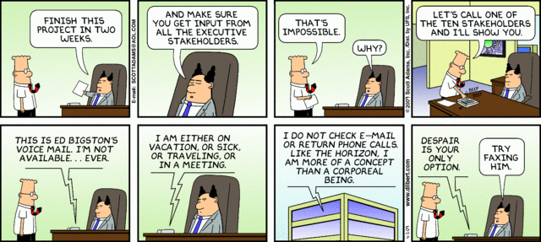

Slide 7
Name | Role | Responsibility | Signature
 | Project Sponsor
 | Project Manager
 | Transportation Director
 | Human Resource manager
 | Construction manager
 | Purchase Director
 | Finance Manager

Slide 8
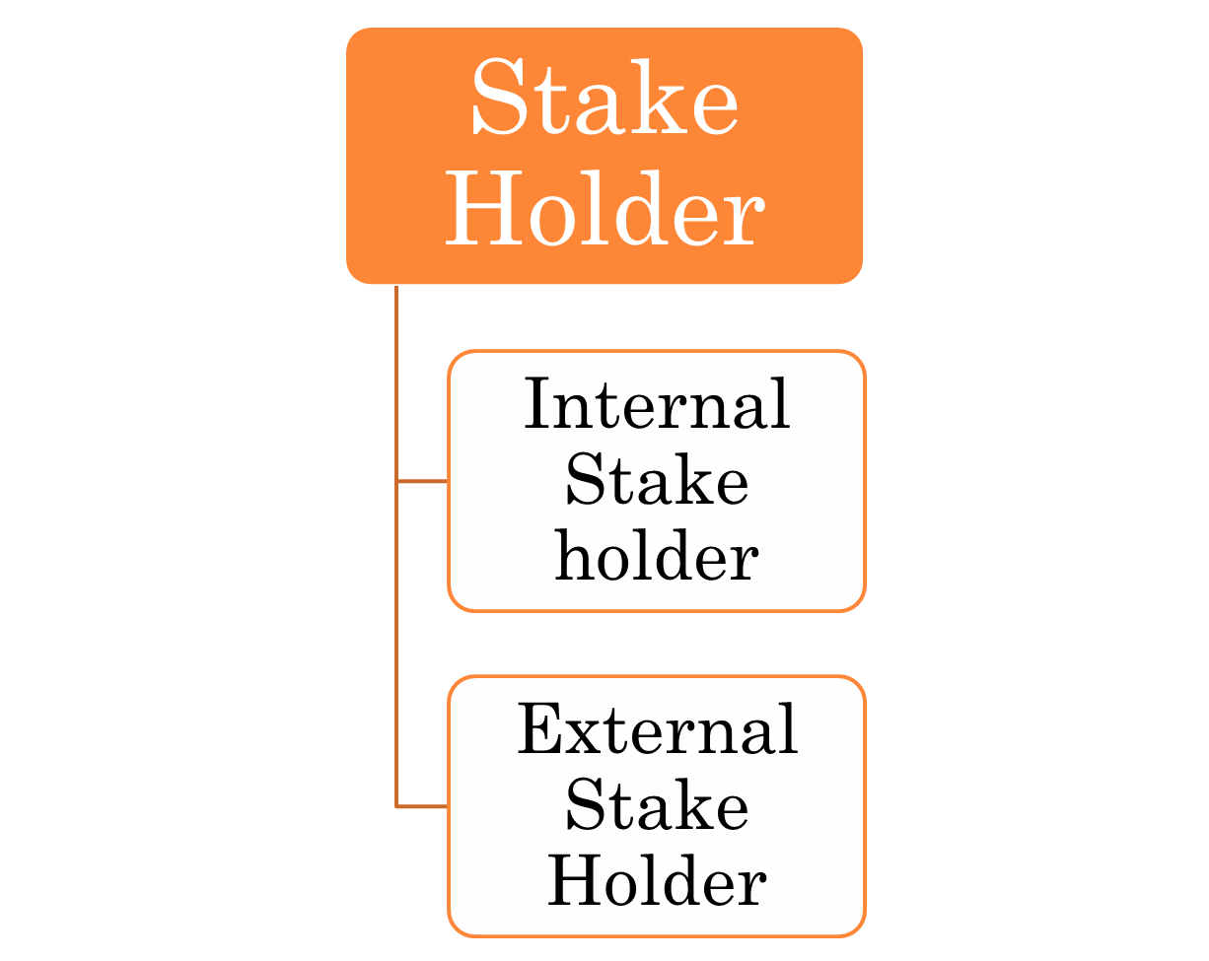
sponsor ,internal customer or client (if project is arise due to internal need of an organization) project team, program manager, portfolio manager etc
external customer or client (if project is arise due to some contract),
end users of project’s outcome,
Supplier,
sub-contractors
Government,
local communities,
Media etc

Slide 9
3. Project/Service Description:
3.1: Project Objectives/Business Justification:
The objective of the project should “clearly stated” and contain a “measure” of how to assess whether they have been achieved. It should be realistic, and include the objectives. It should follow the SMART protocol:
Specific (get into the details)
Measurable (use quantitative language so that you know when you are finished)
Acceptable (to stakeholders)
Realistic (given project constraints)
Time based (deadlines, not durations)

Slide 10
Project Objective | Why you are taking this project Maximum allowance to complete the project: Cost:

Slide 11
3.2: Project Deliverables:
A list of the deliverables that will result from the project are described
WBS (work Break down Structure)
3.3: Project Exclusion:
List of those items which will be beneficial for the project but unfortunately are not included in plan
3.4: Project milestones:

Slide 12
MILE STONES
Activities(Example) | Years | 2012 | 2012 | 2012 | 2012 | 2012
 | Months | June | July | August | September | October
Land Procurement |  | --------- | -------
Vendor Selection |  |  | -------
Construction Material Purchasing |  |  |  | -------
etc |  |  | ------- | -------
etc |  |  |  |  | ________
Finishing touch up |  |  |  |  |  | ______

Slide 13
3.5. PROJECT APPROACH
Describe primary plans briefly on the following (Will the project have formal written plans – i.e., Project Schedule, Budget, Resource? How will project issues be dealt with? List any scheduled project team meetings, planned status reports)
Project Schedule
Budget Allocation
Resources: Material, Human etc
Monitoring Steps
Administrative approach

Slide 14
3.6. ASSUMPTIONS AND CONSTRAINTS
In completing the project we need to establish some assumptions.
Assumptions (example.)
Project will start in time
Employee will work giving their most
Constraints:
Include both internal risks and external risks.
Constraints(Example)
Vendors may provide low quality products

Slide 15
3.7. PROJECT SUCCESS CRITERIA
Define what must be done in order for this project to be considered a success by its stakeholders.
Examples:
Proper implementation needs to be in place

Slide 16
4. SIGN-OFF
 | Name | Signature | Date (M/DD/YY)
Project Sponsor
Co-Sponsor
Project Manager

